Slide 1

Welcome to knowledge centre and maintenence hub for machines pertaining to wheel shop by
SWL Group

Slide 2
POPULATION OF SURFACE WHEEL LATHE
S.NO | SHOP | No OF SWL | TYPE | MAKE
1 | GOC | 02 | 01-CNC 01-CONVENTIONAL | M/s.HYT
2 | MYS | 01 | 01-CNC | M/s.HYT
3 | UBLS | 03 | 03-CNC | M/s.HYT
4 | RYPS | 05 | 02-CONVENTIONAL 03-CNC | M/s.HEC/RANCHI M/s.HYT

Slide 3
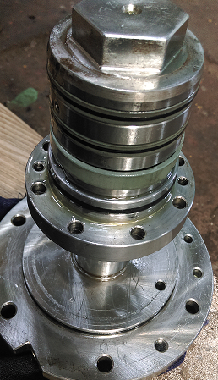
KNOWLEDGE SHARING
S No | Trouble | Trouble shooting | picture
1 | Jaw carrier oil leakage | 1. find the route cause for the oil leakage 2.change the damaged hydraulic seals if damaged with standard 3.find the any unusual and rectify it .
2 | Lifting jack of the machine is not taking load in auto cycle mode | 1.check the lifting jack working in manual mode or not 2.check the any oil leakage at lifting jack cylinder 3.check for the inter locking 4.check the pressuere at lifting jack 5.check whether solenoid valve is activating or not.

Slide 4
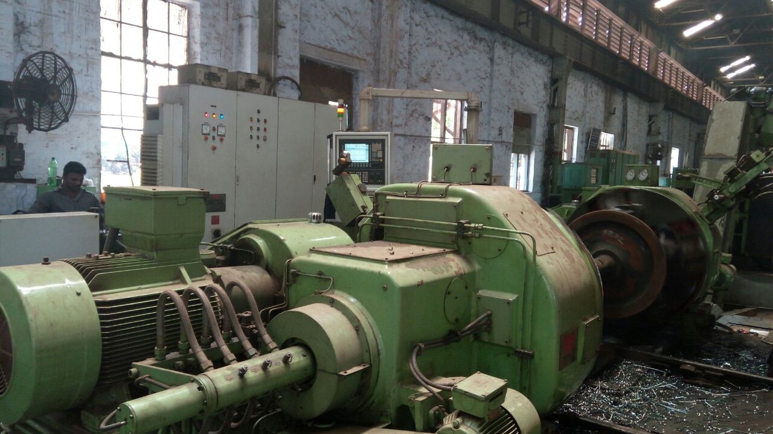
SURFACE WHEEL LATHE - GOC
CU320 CONTROL MODULE OF CNC 840D FAILED
NEW MODULE PROCURED
SIEMENS SALES MANAGER HELPED TO IDENTIFY THE SOURCE FOR PROCUREMENT
NEW MODULE COMMISIONED BY THE SUPPLIER BY LOADING THE PARAMETERS IN DEFECTIVE MODULE

Slide 5
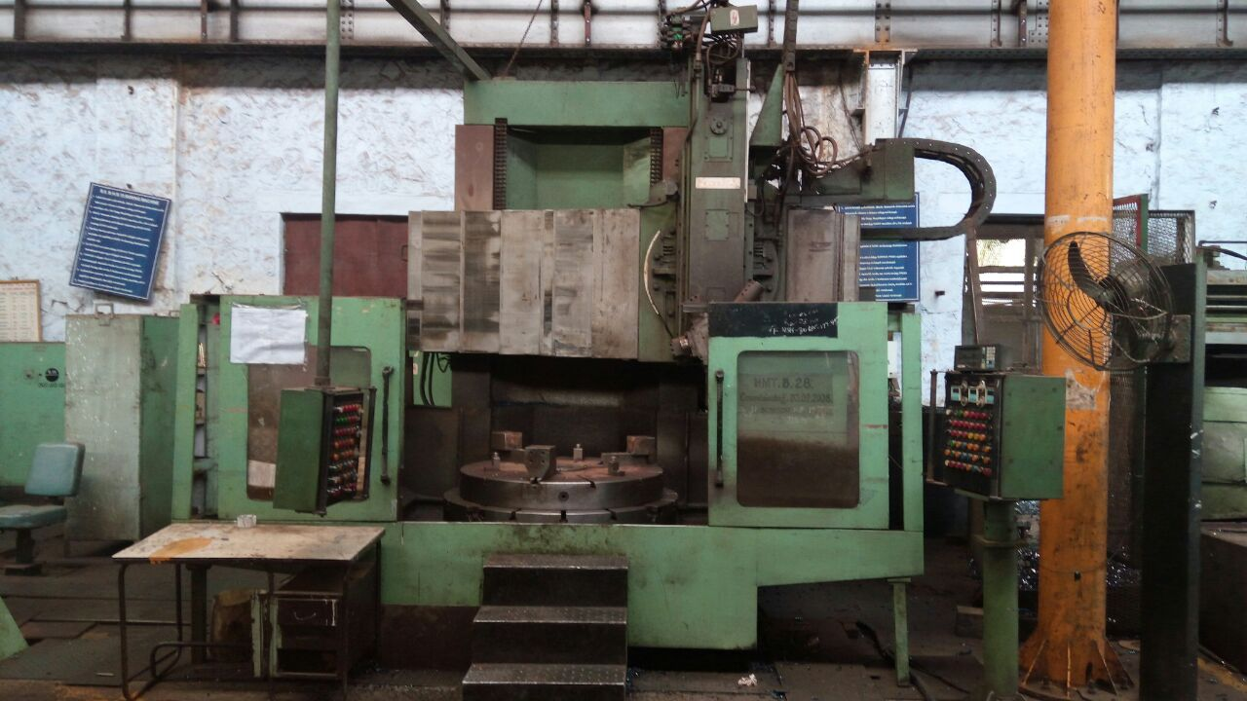
VTL / WHEEL SHOP - GOC

Slide 6
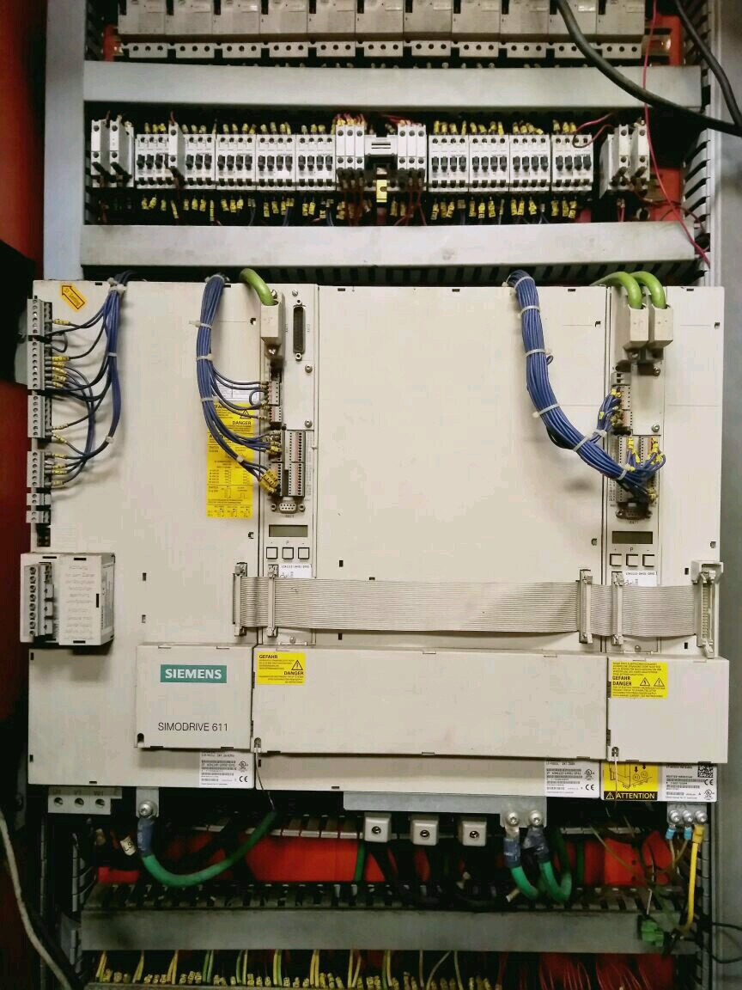

DRIVE MODULE OF VTL - GOC
1.) X AXIS SERVO DRIVE POWER MODULE PCB FAILED
2.) SPARE PCB PROCURED (PAC) AND PROVIDED
3.) PROCUREMENT DELAYED BY 3 MONTHS SINCE SIEMENS INSISTED FOR
100 % ADVANCE PAYMENT

Slide 7
TRAINING NEEDS
S NO | AREA | REQUIRED FOR
1 | HYDRAULICS | MECH STAFF
2 | ELECTRICAL CIRCUITS | ELECTRICAL
3 | CNC PROGRAMMING AND TROUBLE SHOOTING | ELECTRICAL STAFF
4 | G-CODE PROGRAMMING | OPERATORS

Slide 8
PREVENTIVE MAINTENANCE AND AMC
Inhouse expertise should be developed by selecting ITI (electrical and electronics ) background technicians. Till such time AMC is to be given to OEM
Repair manual and parts catalogue to be supplied by OEM along with the machine.
Knowledge center should collect the soft copy of the manuals and parameters loaded in machines.

Slide 9


